Slide 1
Alliance Visions in Orlando
The Alliance
A temporary alliance to move digital pathology, ML/AI and precision medicine forward
Joe Lennerz – MGH/HMS Jlennerz@partners.org
Esther Abels – PathAI & DPA esther.abels@pathai.com
and many more

Slide 2
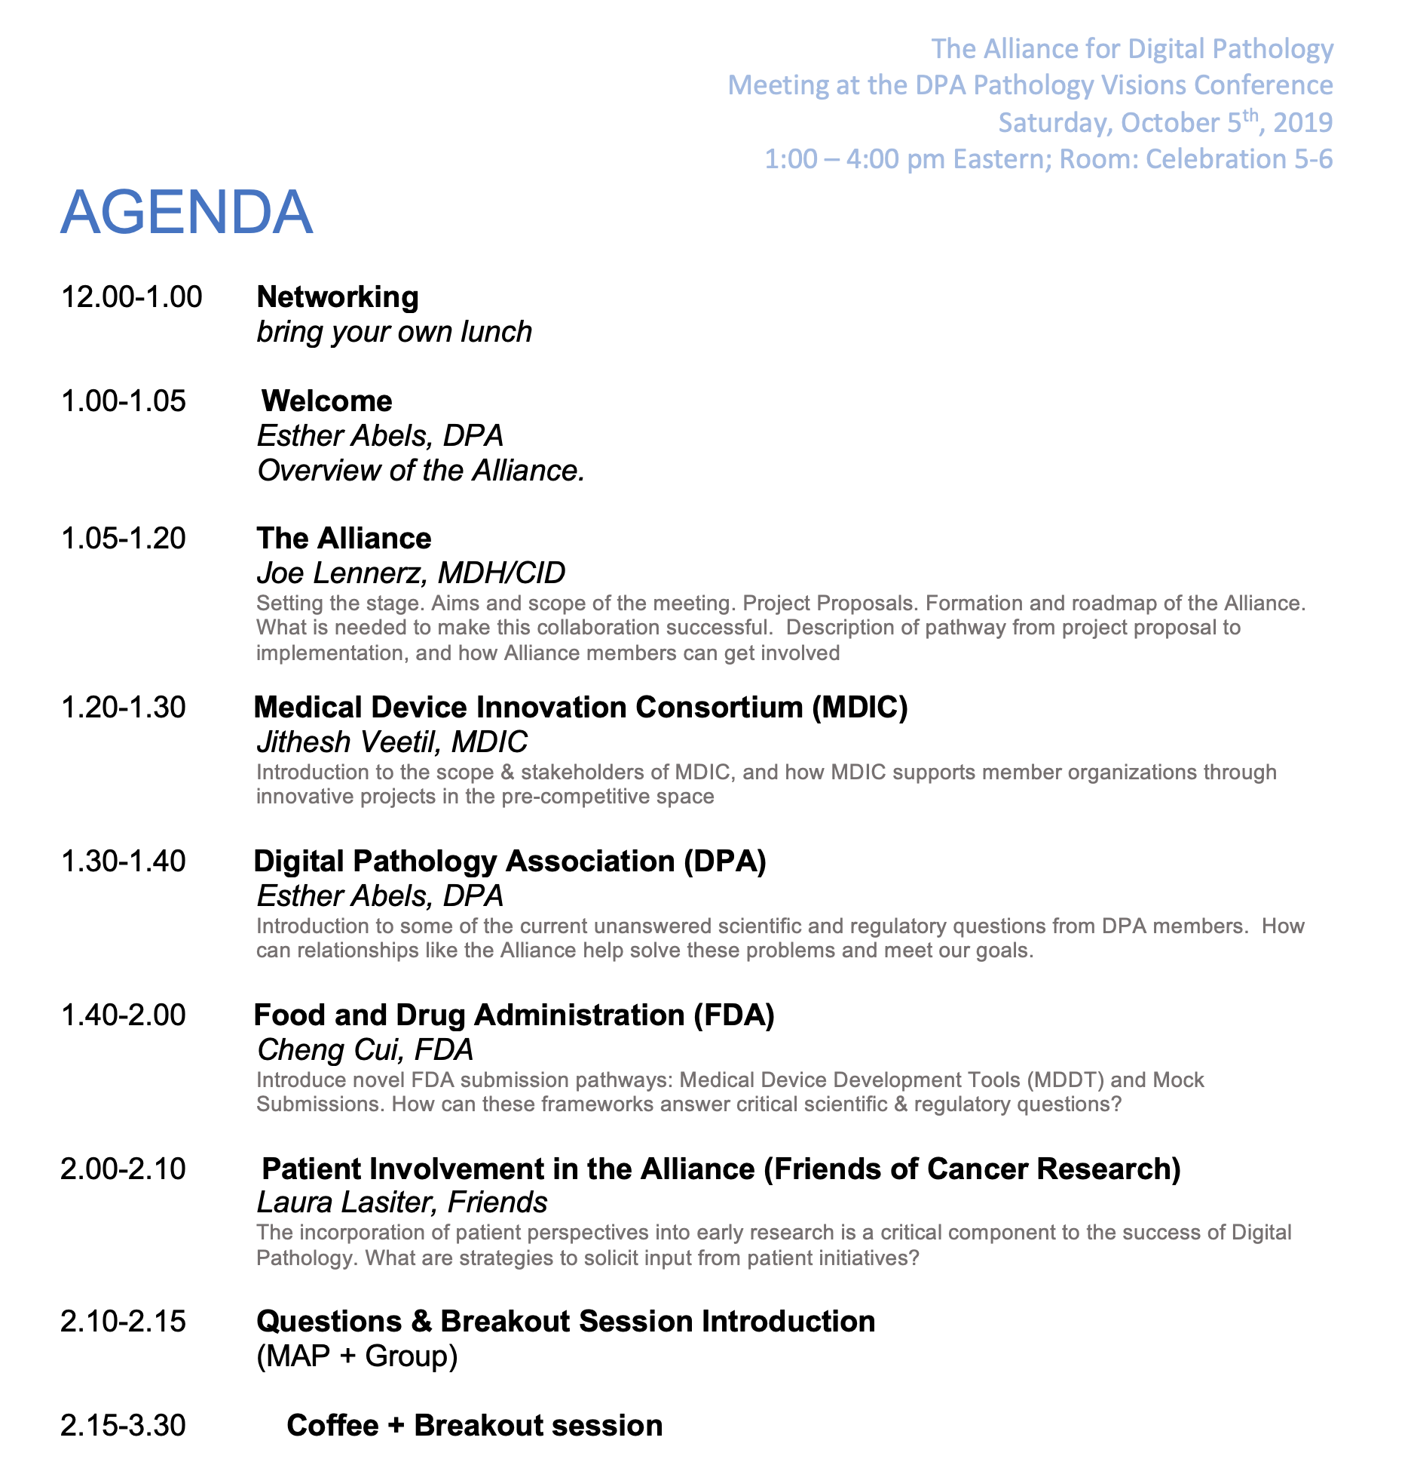
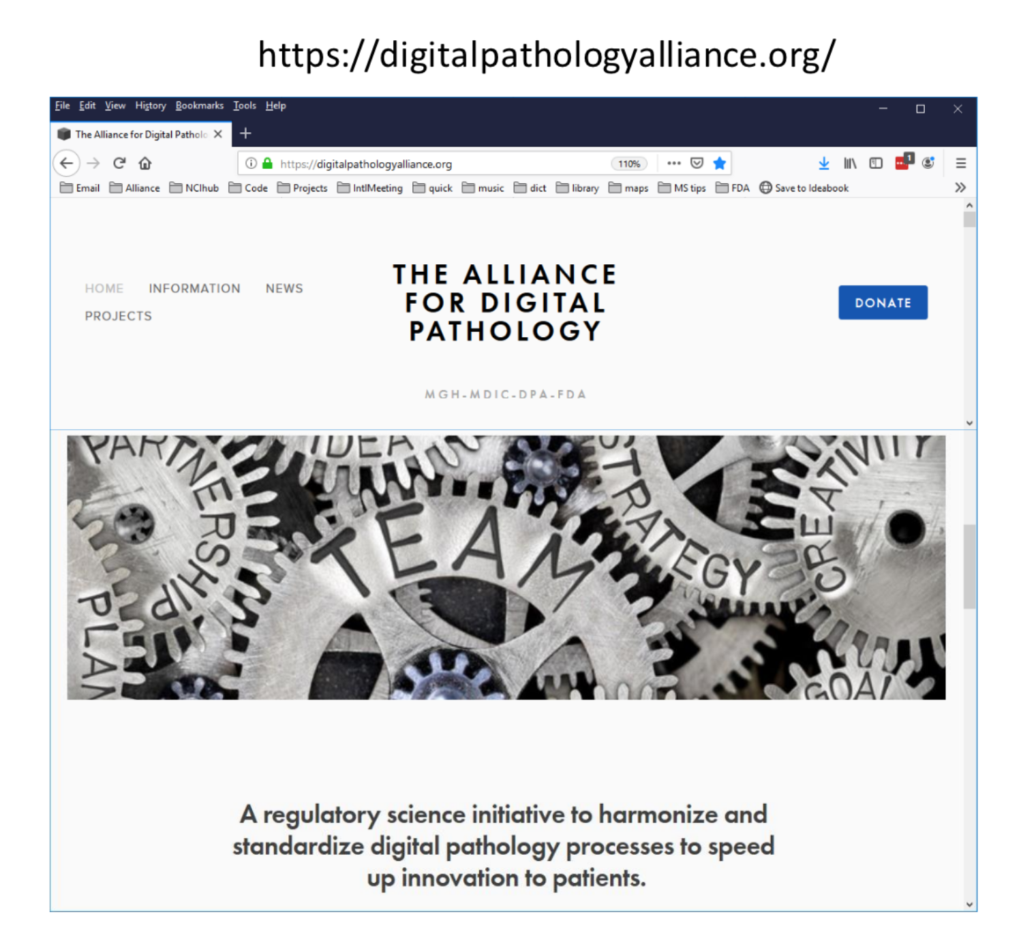

Slide 3
OutLINe
OutLINe
Welcome
Setting the stage
Aims and scope
Survey results
Roadmap of the Alliance
Project Proposals
What is needed to make this collaboration successful
From project proposal to workstream
How can Alliance members get involved?

Slide 4
OutLINe
OutLINe
REGULATORY
SCIENCES
Welcome
Setting the stage
Aims and scope
Survey results
Roadmap of the Alliance
Project Proposals
What is needed to make this collaboration successful
From project proposal to implementation
How can Alliance members get involved?

Slide 5
scientific and technical foundations upon which regulations are based in various industries
REGULATORY
SCIENCES
The objectives, stated by the FDA in 2010 will provide a basis to:
Improve capacity for safety and efficacy evaluations and monitoring of candidate and licensed products,
Modernize current regulatory pathways,
Develop new regulatory pathways where there are currently none.

Slide 6
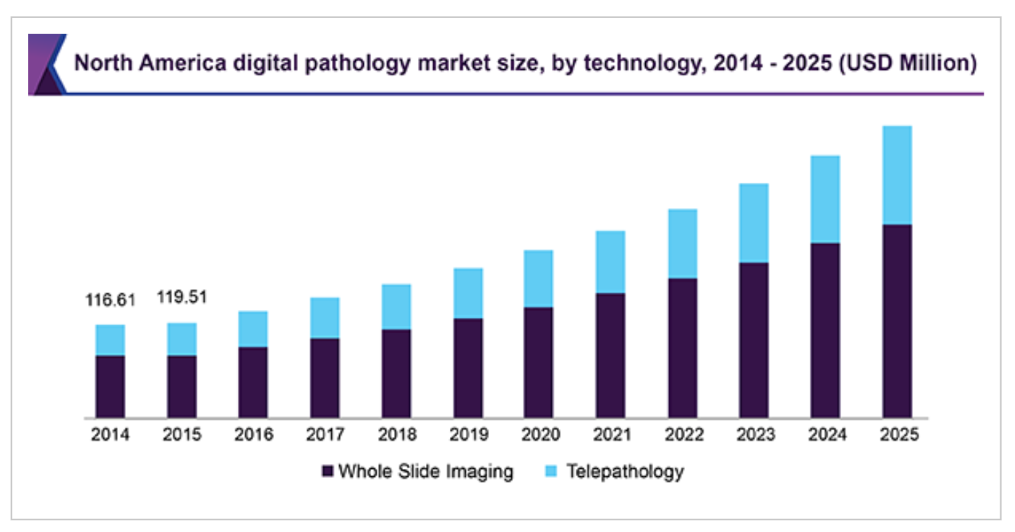
Executive Summary
First WSI systems received FDA 510(k) Clearance 2017 and 2019
Different offerings from archiving to full solutions including algorithms
By 2025 Digital Market is $887.7 million with 12% CAGR
We are re-defining a market
Source:

Slide 7
Why has digital pathology not been realized?
ROI of Digital Pathology Today is a Challenge
Technical challenge AND
Demonstrate a clear and definitive savings in time or money OR
An improvement in the effectiveness of services

Slide 8
Digital Pathology, ML + AI will…
…have obvious and substantial impact on workflow
…entail substantial IT and infrastructure revisions
…require full realization to see overall benefits
Digital Pathology can improve efficiency by ~13%
Ho J, Ahlers SM, Stratman C, et al. Can digital pathology result in cost savings? a financial projection for digital pathology implementation at a large integrated health care organization. J Pathol Inform. 2014;5(1):33;

Slide 9
A regulatory science initiative to harmonize and standardize digital pathology processes to speed up innovation to patients.
SCIENCE
INNOVATION
PATIENT
PERSPECTIVE
REGULATORY
SCIENCES
The Alliance for Digital Pathology is a collaborative and voluntary group interested in the evolution of regulatory science as it applies to digital pathology. We seek participation from all stakeholders(industry, vendors, academic medical centers, patient advocates, regulatory bodies, associations etc.) to come together and identify key elements necessary to move the field of digital pathology forward.
The purpose of the Alliance is to accomplish concrete practical deliverables and relevant strategic aims in order to sustain and expand the existing collaborative infrastructure.

Slide 10
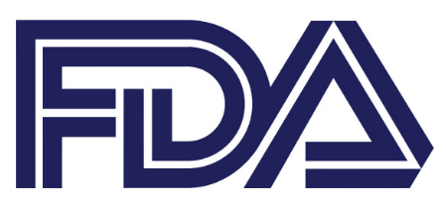
Market analysis
Diverse professional societies
tackle different problems
conflict: progress vs. safety
AI, Deep learning, ML
Substantial change
Software as a Medical Device
Industry + Implementation
one-off solutions
conflict: effort vs. ROI
“NEED for a framework
to synergize and tackle larger scale projects”
FDA
“Voice of Reason”
assess effectiveness and safety
focus
intended use
Challenges
Time to review
Scope
Effort
New pathways
MOCK submission
MDDT pathway
precertification
…

Slide 11
AIMS AND SCOPE OF THE ALLIANCE
Tackle large-scale projects in pre-competitive space
Develop evaluation tools, methods, and standards
Clarify and improve regulatory pathways

Slide 13
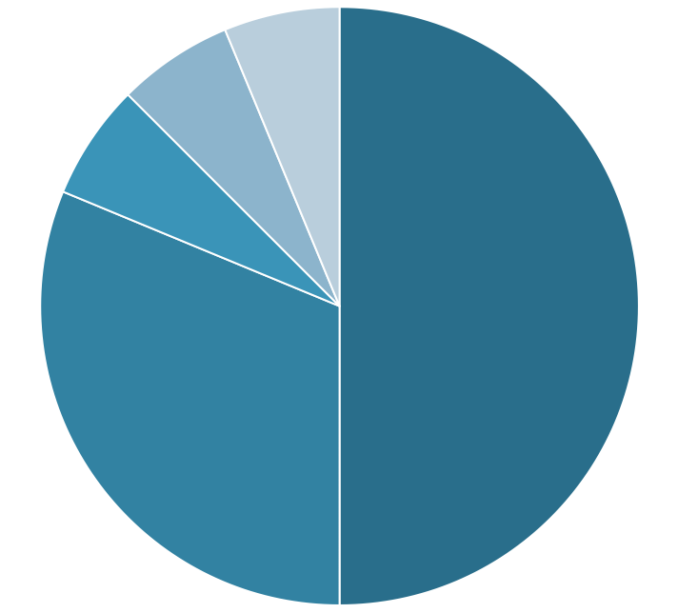
Alliance Survey Results Overview
Marble, Dudgeon, Huang, et al., unpublished
DEMOGRAPHICS
SELECTED RESPONSES
N=42 Respondents
>229 Papers
>211 Years experience
38%
62%
Familiar with the MDIC?
No
Yes
Include patient advocacy?
20%
80%
Years involved in digital pathology
No
Yes
22%
39%
39%
FDA oversight is
<1 year
1-5 years
5-10 years
>10 years
Too simple
Adequate
Too complex
Self-assigned sector
Should focus include….
Other 6%
32%
68%
Industry 50%
…slide generation?
Government 6%
No
Yes
Non-government 6%
25%
75%
Academia 32%
…metadata capture?
N=32 respondents
No
Yes

Slide 14
Alliance Survey Results Overview
Percent respondents
Marble, Dudgeon, Huang, et al., unpublished
20
DICOM
Test Validation
15
10
Pixel data
LIMS
Metadata
Deployment
Compute
Model
Utilization
Slides
Scan
5
Archive
EHR
Store
0

Slide 15
From project proposal to workstream
Alliance
Steering Committee
Industry
FDA
Project
proposal
Governance
Prioritization
Administration
AMC’s
Patients

Slide 16
What is needed to make this collaboration successful
You
Enthusiasm
Magic
How can Alliance members get involved?

