Slide 1
MDDT Program and Mock Submissions
The Alliance for Digital Pathology
October 5th, 2019
Cheng Cui
FDA/CDRH/OPEQ/OHT7(OIR)/DMGP
Notes:
Good afternoon, everyone.
Now I am going to give you an introduction of FDA’s MDDT program and Mock pre-submissions.

Slide 2
FDA / CDRH / OPEQ / OHT-7(OIR) / DMGP
Cheng Cui, a scientific reviewer in the Division of Molecular Genetics and Pathology
Our division oversees the regulation of digital pathology medical devices
Notes:
My name is Cheng Cui and I am a scientific reviewer at the division of Molecular Genetics and Pathology , now OHT-7
in the
Office of In Vitro Diagnostics and Radiological Health
Our division oversees the regulation of digital pathology medical devices.

Slide 3
Disclaimer
This presentation is intended for informational purposes only and does not constitute legal or regulatory advice. Please see the Federal Food, Drug, and Cosmetic Act and 21 CFR Subchapter H for a full list of requirements by FDA.

Slide 4
MDDT Program
Notes:
Let’s take a look of the MDDT program.

Slide 5
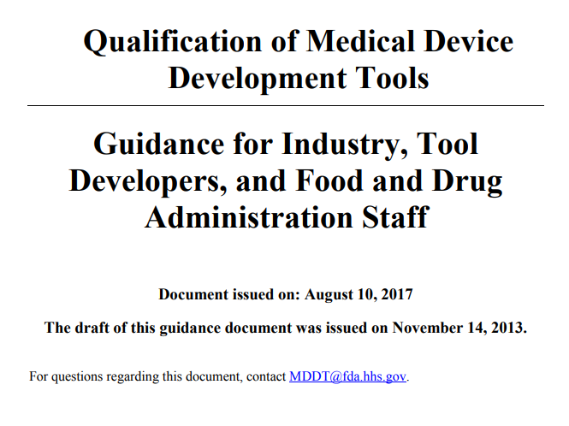
MDDT Final Guidance
Notes:
The Pilot MDDT program started in 2013 and a final FDA guidance, Qualification of Medical Device Development Tools, was issued in August 2017.
What I will go over today about the MDDT program is covered in detail in this guidance.
Therefore, I would recommend refer to this guidance if you have any questions regarding MDDT program, or you can contact MDDT program directly by sending an email to MDDT@fda.hhs.gov.

Slide 6
MDDT reduces regulatory burden
Medical Device Development Tool (MDDT) Program: Benefit of Qualifying Tools
Research
Development
Promotes Efficient Medical Device Development
Tool Developer
Device Industry
Patients
FDA-Product Evaluators
FDA- Regulatory Scientists
Fosters innovation
Encourages collaboration
Reduces resource expenditure
Qualified MDDT applied in multiple device submissions
Promote efficiency in CDRH regulatory review resources
Minimizes uncertainty in regulatory review process
Facilitates timely evaluation
Notes:
First, I want to start with the purposes of having this MDDT program.
Through MDDT program, the Agency hopes the MDDT program can foster …
The Agency also hopes that MDDTs, once been qualified by the Agency, can be applied in multiple device submissions to reduce regulatory burden.

Slide 7
MDDT reduces regulatory burden
Medical Device Development Tool (MDDT) Program: Benefit of Qualifying Tools
Research
Development
Promotes Efficient Medical Device Development
Tool Developer
Device Industry
Patients
FDA-Product Evaluators
FDA- Regulatory Scientists
Fosters innovation
Encourages collaboration
Reduces resource expenditure
Qualified MDDT applied in multiple device submissions
Promote efficiency in CDRH regulatory review resources
Minimizes uncertainty in regulatory review process
Facilitates timely evaluation
Notes:
The Agency also hopes that qualified MDDTs can
promote efficiency in CDRH regulatory review resources,
minimize uncertainty in regulatory review process and
facilitates timely evaluation of medical devices.

Slide 8
What Is An MDDT?
Medical Device Development Tool (MDDT) is a method, material, or measurement used to assess the effectiveness, safety, or performance of a medical device.
An MDDT is scientifically validated and qualified for a specific Context Of Use (COU)
COU describes the way the MDDT should be used, purpose in device evaluation and/or regulatory submission, and specific output/measure from the tool
Qualification is an FDA conclusion that within the COU an MDDT can be relied upon to have a specific interpretation and application in medical device development and regulatory review
CDRH reviewers should accept the MDDT outcomes within the qualified context of use (COU) without the need to reconfirm the suitability and utility of the MDDT when used in a regulatory submission

Slide 9
MDDT Types
Clinical Outcome Assessment (COA)
Patient selection for clinical studies
Clinical study outcomes
Objective and subjective
Biomarker Test (BT)
Objective measure of biologic process or response to an intervention
Patient selection
Predict or identify outcomes
Nonclinical Assessment Models (NAM)
Models (computational and animal) to measure/predict a parameter of interest
Reduce / Replace animal testing
Reduce test duration or sample size
Notes:
Based on how the MDDT measures the relevant parameters …
For more details about the definition of these three MDDT types, please refer to the FDA guidance for MDDT

Slide 10
CDRH Qualification Decision Framework
Key considerations for qualifying a proposed MDDT
MDDT description
Context of use
Public Health Impact
Strength of evidence
Assessment of advantages and disadvantages
Notes:
When determining whether to qualify a proposed MDDT, the Agency will consider the following

Slide 11
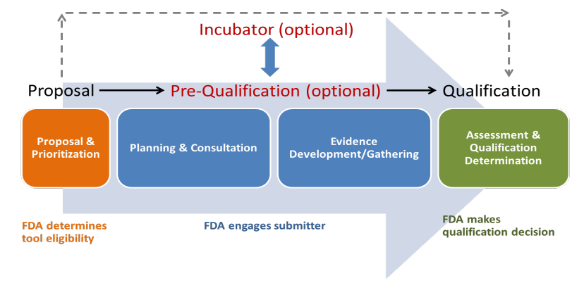
CDRH Qualification Process
Proposal Phase
Incubator Phase (Optional)
Pre-Qualification Phase (Optional)
Qualification Phase
Notes:
The qualification process is composed of four phases, with two phases being optional.
The first phase is the proposal phase
The goal of the proposal phase is to determine if the MDDT is suitable for qualification through the MDDT program
The Agency is expected to respond to the MDDT proposal within 60 days.
After evaluation of the proposal, if the tool is considered suitable for qualification through the MDDT program, the Agency will engage with submitter to determine which follow-up phase is appropriate.

Slide 12
CDRH Qualification Process
Proposal Phase
Incubator Phase (Optional)
Pre-Qualification Phase (Optional)
Qualification Phase
Notes:
The Qualification Process can go …
Directly to last phase, qualification phase if ready for review;
Pre-qualification phase: if the submitter needs the Agency to provide feedback on the plan to collect evidence to support qualification of the tool.
Incubator phase: if the Agency needs to work with the submitter to foster the development of tools that have potential to significantly improve public health.

Slide 13
Qualification Phase
Submitters should provide complete qualification package that includes
all descriptive elements and protocols as described in the proposal and pre-qualification sections
statement if tool has been previously submitted to MDDT Program or through the Drug Development Tool Program
MDDT description
all evidence needed to support qualification
discussion of how strength of evidence supports qualification
assessment of advantages and disadvantages for tool use
Appendix 1 of the MDDT guidance provides more details on how to submit a complete qualification package
Notes:
Now what to expect during the qualification phase

Slide 14
MDDT Exciting Growth Opportunities
The MDDT program is seeking new MDDT submissions in the following key areas:
Surrogate outcomes for clinical trials
Biomarker Tests for physiological safety (e.g., electrical hazard, light/EM radiation hazard, biocompatibility, toxicology)
Bench Testing Evaluation Methodologies
Computational Modeling and Simulation tools
Phantom Tools
Image Databases with Ground Truth Annotation
Notes:
Last but not the least, Image databases with ground truth annotation

Slide 15
Resources for More Information
Inquiries for Additional Information email: MDDT@fda.hhs.gov
FR notice announcing the MDDT Program (8/10/2017): https://www.federalregister.gov/documents/2017/08/10/2017-16827/qualification-of-medical-device-development-tools-guidance-for-industry-tool-developers-and-food-and
MDDT Guidance Document: https://www.fda.gov/ucm/groups/fdagov-public/@fdagov-meddev-gen/documents/document/ucm374432.pdf
MDDT Public Webpage:
http://www.fda.gov/MedicalDevices/ScienceandResearch/MedicalDeviceDevelopmentToolsMDDT/default.htm
Q-Submission Guidance Document: https://www.fda.gov/ucm/groups/fdagov-public/@fdagov-meddev-gen/documents/document/ucm311176.pdf
Notes:
Additional resources can be found at following FDA webpages.

Slide 16
Mock submissions

Slide 17
Two Mock Q-Subs
Mock pre-submissions for Protein-based multiplex assays (2008-2010)
Mock Q-subs for Virtual Patient (VP) Model submitted by MDIC (2015-2016)
Notes:
So far there have been two mock submissions, or rather mock pre-submissions received by the Agency.
NCI …
Medical Device Innovation Consortium …
The purpose of the Mock submission is to bring transparency regarding the Agency’s current thinking for topics that multiple companies are interested in.

Slide 18
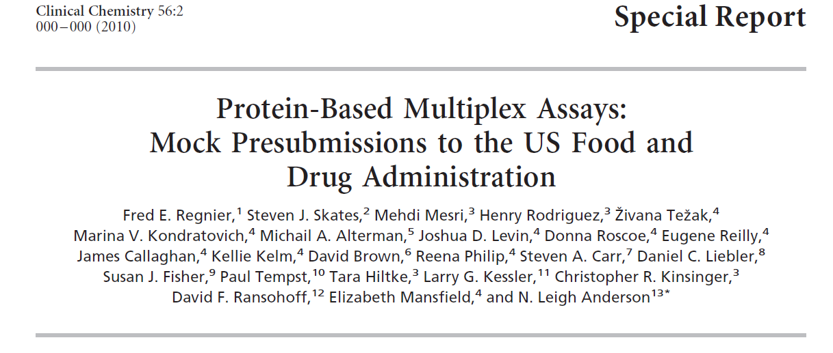
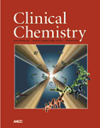
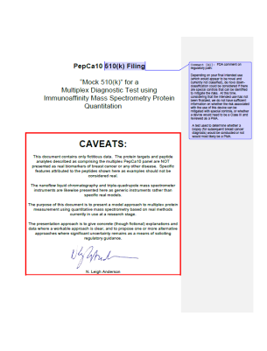
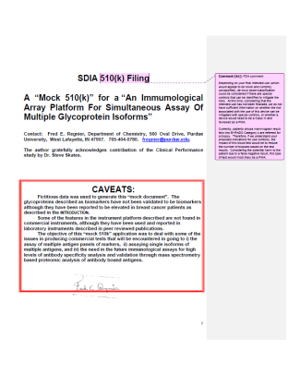
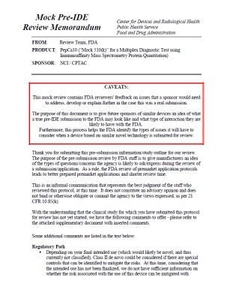
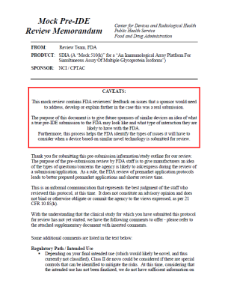
Mock pre-submissions for Protein-based multiplex assays
Mock pre-submissions to FDA:
Multiplex Proteomics Mass Spectrometry platform
Multiplex affinity arrays
Submitted to FDA for review
“Lessons learned” intro paper
Serve as examples of review comments to the proteomics community
Regnier FE, et al. Protein-Based Multiplex Assays: Mock Pre-submissions to the US Food and Drug Administration. Clin Chem 56, 165-171, 2010.
Supplementary Materials
(Multiplex MRM mass spec & immunoaffinity array filing with FDA review memo)
Notes:
The mock pre-submissions from NCI included Multiplex Proteomics Mass Spectrometry platform, and Multiplex affinity arrays.
The pre-submissions were submitted to FDA for review.
After FDA review, a “Lessons learned” intro paper … Clinical Chemistry … special report
The supplemental materials of the paper included: original pre-submissions and corresponding FDA feedbacks.
The mock pre-submissions for protein-based multiplex assays serve as examples of review comments to the proteomics community that reflect our thinking at that time.

Slide 19
Mock Q-subs for Virtual Patient (VP) Model
Mock Q-Subs to FDA:
Q150804 – Informational Meeting request
Q150804/S001 – Pre-submission with an overview of the engineering model used to generate virtual patients
A follow-up pre-sub with clinical study proposal
Submitted by MDIC working group on clinical trials informed by bench and simulation
MDIC Website: https://mdic.org/project/virtual-patient-vp-model/
MDIC Website includes overview and
Working group description and opportunity
Virtual patient framework
Documents from the mock Q-subs
Notes:
The mock Q-subs for Virtual Patient Model were submitted by MDIC working group on clinical trials informed by bench and simulation, under Q150804.
Started with an informational meeting request, followed by two supplements.
The first supplement had an overview …
The second supplement had a clinical study proposal
The Agency provided comments for these mock Q-subs.

Slide 20
Mock Q-subs for Virtual Patient (VP) Model
Mock Q-Subs to FDA:
Q150804 – Informational Meeting request
Q150804/S001 – Pre-submission with an overview of the engineering model used to generate virtual patients
A follow-up pre-sub with clinical study proposal
Submitted by MDIC working group on clinical trials informed by bench and simulation
MDIC Website: https://mdic.org/project/virtual-patient-vp-model/
MDIC Website includes overview and
Working group description and opportunity
Virtual patient framework
Documents from the mock Q-subs
Notes:
For more information, you can go to MDIC webpage for this project that includes an overview of the project, working group …

Slide 21
Questions Cheng.Cui@fda.hhs.gov

