Slide 1
Instructions
This slide deck will be used to present 2023 annual updates to senior leadership team in May 2024 for all collaborative communities
Use the template on the following slides to create a succinct update
All content must fit within the allocated space
Follow the help text in italics when adding content

Slide 2
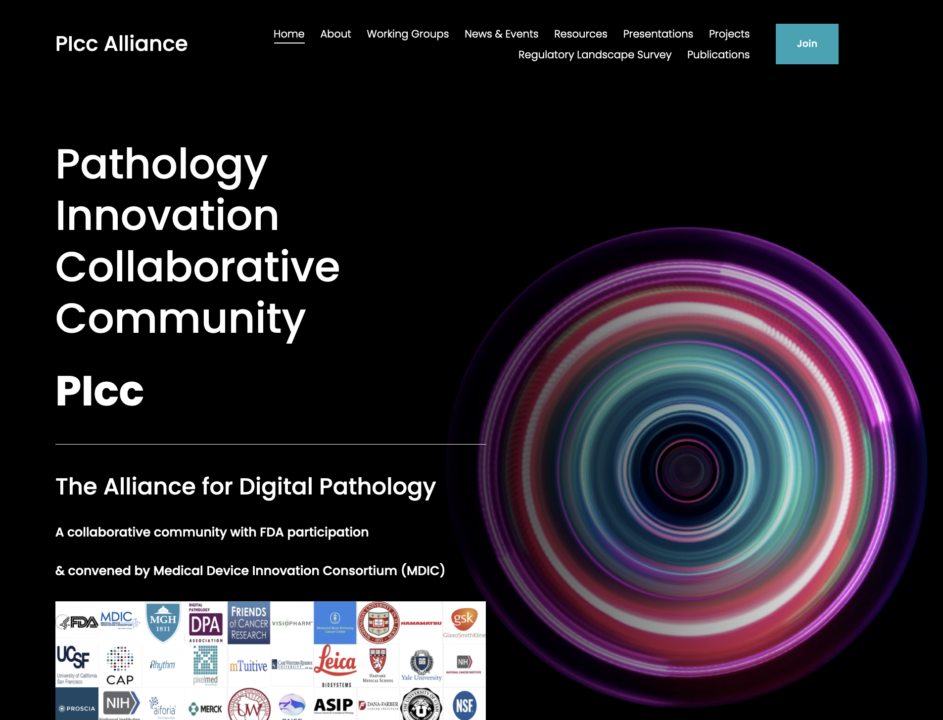
Pathology Innovation Collaborative Community PIcc
PIcc is a temporary regulatory science initiative that aims to facilitate innovations in pathology as well as advance safety and effectiveness evaluation, and to harmonize approaches to speed delivery to patients using collaborative, pre-competitive approaches.
www.pathologyinnovationcc.org
CDRH Liaison: Brandon Gallas
CDRH Executive Sponsor: Ed Margerrison
www.pathologyinnovationcc.org

Slide 3
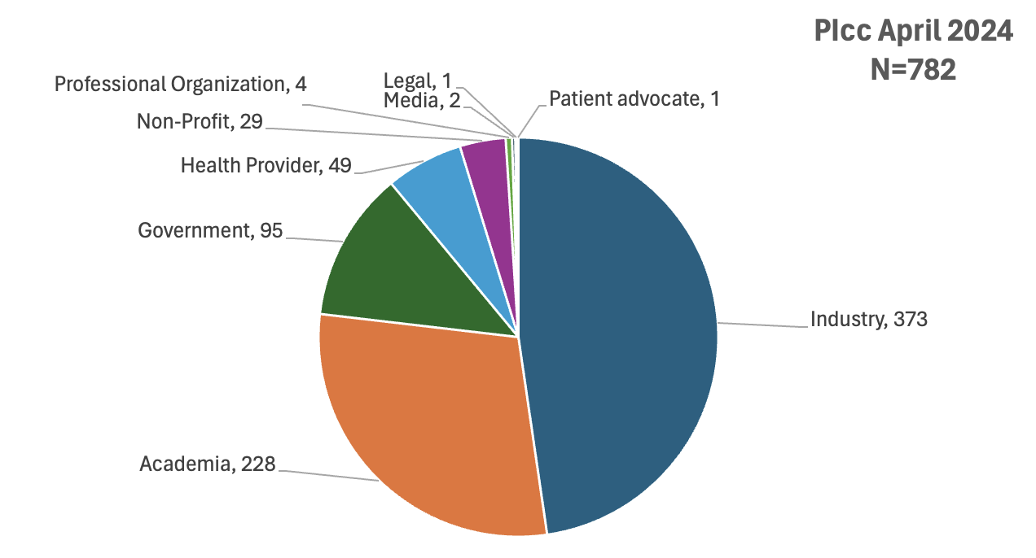
PIcc brings together a broad range of stakeholders to accelerate the development and delivery of regulatory science initiatives in the pre-competitive space that modernize the clinical practice of pathology.
Key aim: a clear path for regulation of pathology innovation through regulatory science
Inclusive organization for all stakeholders to educate each other and tackle relevant questions by using and creating applicable regulatory science tools
CDRH engagement through representative participation and contribution

Slide 4
Collaborative Community Activities
2023 Goals
2024
Goals from 2022
Continue meeting and sharing important information and activity in the field
In-person working meeting D.C. area in collaboration with MDIC (convener of PIcc)
Additional meet-ups at conferences of member organizations
Increase engagement through active member participation
Grow website traffic and recognition of the website as a resource through increased social media presence
Accomplished?
New projects launched:
HER2-low
PCCP
data breach project
Meeting
In-person meeting D.C. area in collaboration with MDIC (convener of PIcc)
Website traffic
Additional
FNIH Meeting with key stakeholder
PIcc FNIH Project (multi-center data collection initiative). Multi-phase project
Regulatory Science Landscape Survey
Capture key concerns in the community
Share this on website and with FDA
In-person meeting (Fall)
Planning
Publications
CME course (jointly with FDA)
MDDT submission experience

