Slide 1
Friends of Cancer Research: Research Partnerships Harmonization Efforts
July 13, 2022

Slide 2
The Friends’ Collaborative Model
Bring together diverse stakeholders
Conduct assessments and propose solutions
Publish white papers and publications
Identify key challenges
Align and implement
Use findings to drive change

Slide 3
TMB Harmonization Project
The Definition
The Problem
The Solution
The Definition | The Problem | The Solution
Tumor mutational burden (TMB) measures the quantity of mutations found in a tumor. | There is a lack of standardization for TMB calculation and reporting. | A unique research partnership to develop alignment strategies for measuring TMB.
This type of biomarker may help predict the likelihood a patient with cancer will benefit from immuno-oncology (IO) therapies. | Different tests may report different measurements, and since there is no standardized way of calculating TMB it is difficult to use as a biomarker. | Friends convened stakeholders to review the current methods of TMB calculation and reporting and create a consensus solution on how best to standardize them. The group proposed analytical and clinical validation studies to support a standardized method of TMB measurement.

Slide 4
TMB Harmonization Project
Workflow
Phase 1
In Silico Analysis
Phase 2
Empirical Analysis
Phase 3
Clinical Analysis
Objectives | To identify sources of variability between TMB calculated using whole exome sequencing (WES) and various targeted panels used in the clinic | To agree upon creation of a universal reference standard using WES To identify sources of variability after alignment of TMB scores from targeted panels to the reference standard | To propose standards for defining clinical application of TMB and inform clinical use To develop a calibration tool to promote reproducibility and comparability across assays
Approach | 11 different laboratories use publicly available TCGA data | 16 different laboratories use cells derived from human tumors | 16 different laboratories use clinical samples

Slide 5
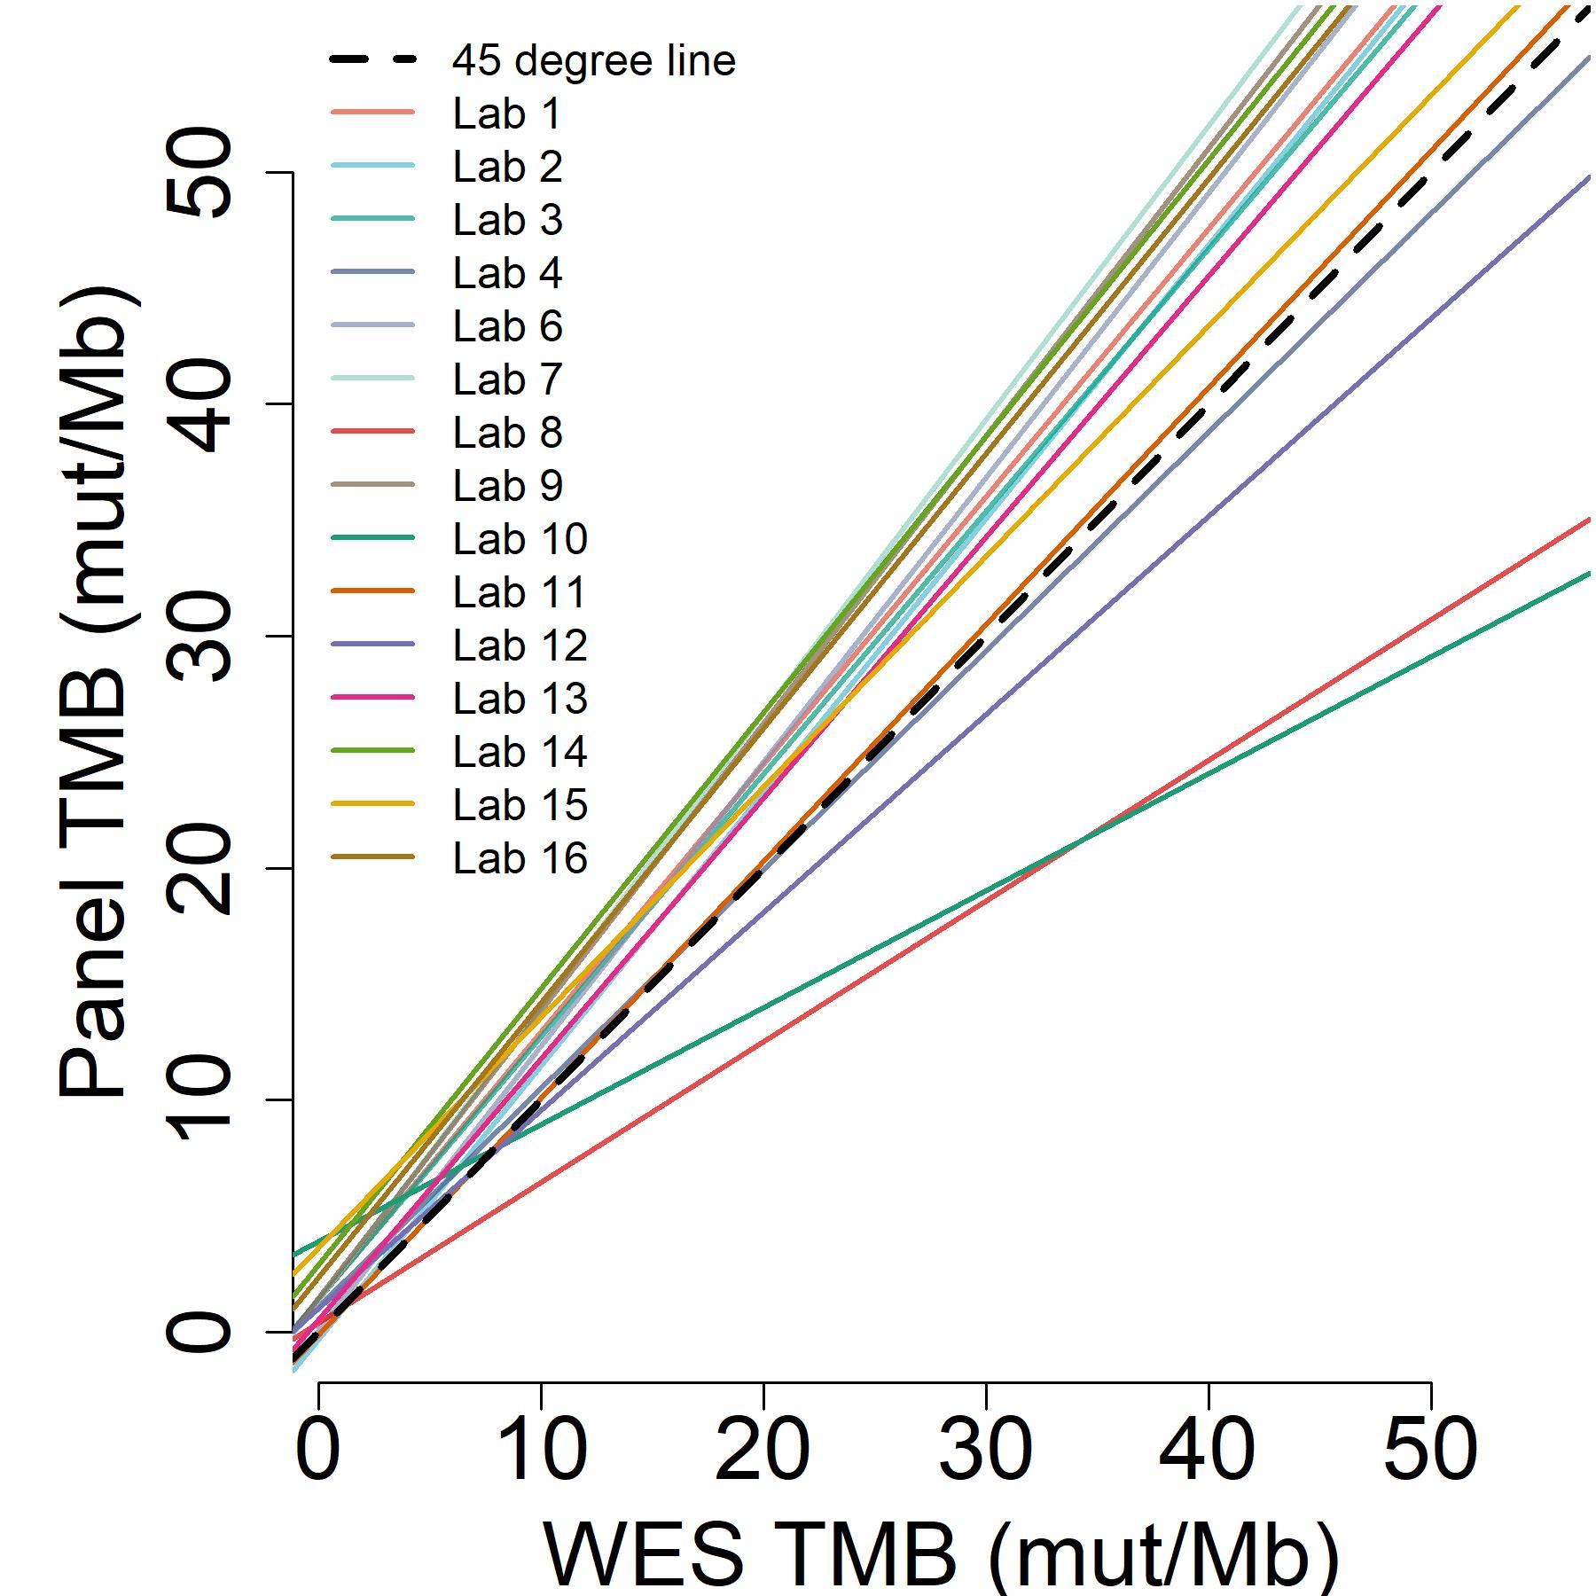
TMB Methodological Approach
Data Source
Gold-standard
Regression curves
TCGA validation cohort samples (N=4065) [Numerous tumor types]
Consortium-agreed WES TMB algorithm
WES TMB score
Human tumor-derived cell lines (N=10)
[Lung & breast cancer]
Comparison of panel TMB to
WES TMB
Panel-specific
Tumor-normal matched FFPE clinical samples (N=35)
[Lung, bladder, gastric and colon]
Partner Laboratory’s TMB algorithm
Panel TMB
score

Slide 6
Selected Outputs from TMB Harmonization
Peer Reviewed Literature
Stenzinger et al, 2019 – Recommendations about use of TMB published in Genes Chromosomes Cancer
Merino et al, 2020 – In silico analysis published in JITC
Vega et al, 2021 – Tumor and cell sample analysis published in Annals of Oncology
Presentations at Public Meetings
SITC 2019 Annual Meeting Presentation highlighting the project
AACR 2020 Annual Meeting Presentation describing findings from the tumor sample analysis

Slide 7
TMB Project Partners
ACT Genomics
AstraZeneca
Brigham & Women’s Hospital
Bristol-Myers Squibb
Caris Life Sciences
Columbia University
EMD Serono
European Organisation for Research and Treatment of Cancer (EORTC)
Foundation Medicine
Guardant Health
Illumina
Johns Hopkins University
Navican
Memorial Sloan Kettering Cancer Center
Merck
National Cancer Institute (NCI)
National Institutes of Health (NIH)
NeoGenomics Laboratories
OmniSeq
Pfizer
Personal Genome Diagnostics
precisionFDA
Q2| EA Genomics
QIAGEN
Regeneron Pharmaceuticals
SeraCare
Thermo Fisher Scientific
U.S. Food and Drug Administration

Slide 8
HRD Harmonization Project
The Definition
The Problem
The Solution
The Definition | The Problem | The Solution
Homologous recombination deficiency (HRD) is a complex biomarker that helps identify whether patients may respond to certain treatments. | Currently, there is no standardized way to define, measure, and report HRD. | A unique research partnership to develop alignment strategies among different methods for measuring HRD and aligning around its use as a biomarker in clinical care.
This type of biomarker has promise in identifying patients with certain cancers who are more likely to benefit from PARP inhibitors and other DNA repair targeting drugs. | A few NGS-based HRD assays are currently available, and these use different approaches to measure HRD. But there is no agreement on what parameters contribute to the determination of a sample’s HR status. | Friends assembled a consortium of project partners from key healthcare sectors to address concerns about the lack of consistency in determining HRD status, its prognostic value, and its use as a predictive biomarker.

Slide 9
HRD Harmonization Project
Workflow
Phase 1
Discovery and Definition
Phase 2
Assay Alignment
Phase 3
Clinical Contextualization
Objectives | To refine the way HRD is being utilized To better understand how HRD calls are being determined To propose a common language around the use of HRD | To understand the level of variability across HRD assays To identify opportunities for harmonization To propose best practices for HRD assay alignment & utilization | To understand how disease context impacts association between HRD and clinical outcome To identify approaches for the development of clinical evidence to evaluate HRD
Approach | Developed a landscape analysis of HRD aimed to identify how HRD is used, define how HRD calls are made, and propose common language around the use of HRD. | Working to establish an analysis plan for 15 diagnostics companies to use to identify variability in assays and opportunities for harmonization. | Report findings from Phase 2 for clinicians and patients and develop an analysis plan to evaluate impacts of HRD testing on clinical efficacy.
Current Output:
Homologous Recombination Deficiency: Concepts, Definitions, and Assays. The Oncologist March 2022.

Slide 10
Complex Biomarkers Harmonizing use to support implementation
HRD Harmonization Project
Do HRD assays report different HR statuses? If so, why might this variation exist?
Describe the variation in HRD assays, then explore potential sources of variation
TCGA- In Silico Analysis
348 ovarian cancer files
DNA Nexus deidentified files and shared with diagnostics developers
Developers analyzed sample files using HRD bioinformatic pipelines
NCI stats team compared assays
Patient Sample Analysis
~125 freshly sectioned ovarian cancer samples
Fredrick National Laboratory will extract and distribute DNA/RNA
Developers will run their HRD assays on samples
NCI stats team will compare assays

Slide 11
HRD Project Partners
Abbvie
ACT Genomics
Ambry Genetics
Amoydx
AstraZeneca
Arizona State University
Bayer
Biodiscovery
Bristol Myers Squibb
Caris Life Sciences
DNA Nexus
EMD Serono
EORTC
Foundation Medicine
Frederick National Laboratory for Cancer Research
GlaxoSmithKline
Guardant Health
Illumina
Invitae
Janssen
MD Anderson
Merck
Myriad
National Cancer Institute
Neogenomics
Novartis
Omniseq
Pfizer
PGDx
Qiagen
Resolution Biosciences
SOPHiA Genetics
Tempus
Thermo Fisher
University of Alabama at Birmingham
University of Heidelberg
U.S. Food and Drug Administration

Slide 12
Applying the Collaborative Model for Digital Pathology
Bring together diverse stakeholders
Conduct assessments and propose solutions
Publish white papers and publications
Identify key challenges
Align and implement
Use findings to drive change
Initial Opportunities:
Outline potential use cases, considerations, and approaches for AI-driven digital pathology in oncology drug development
Identify key challenges/opportunities for alignment of methodology

