Slide 1
SEER Data and Figures
PIcc Data and Review Meeting
09.24.2021

Slide 2
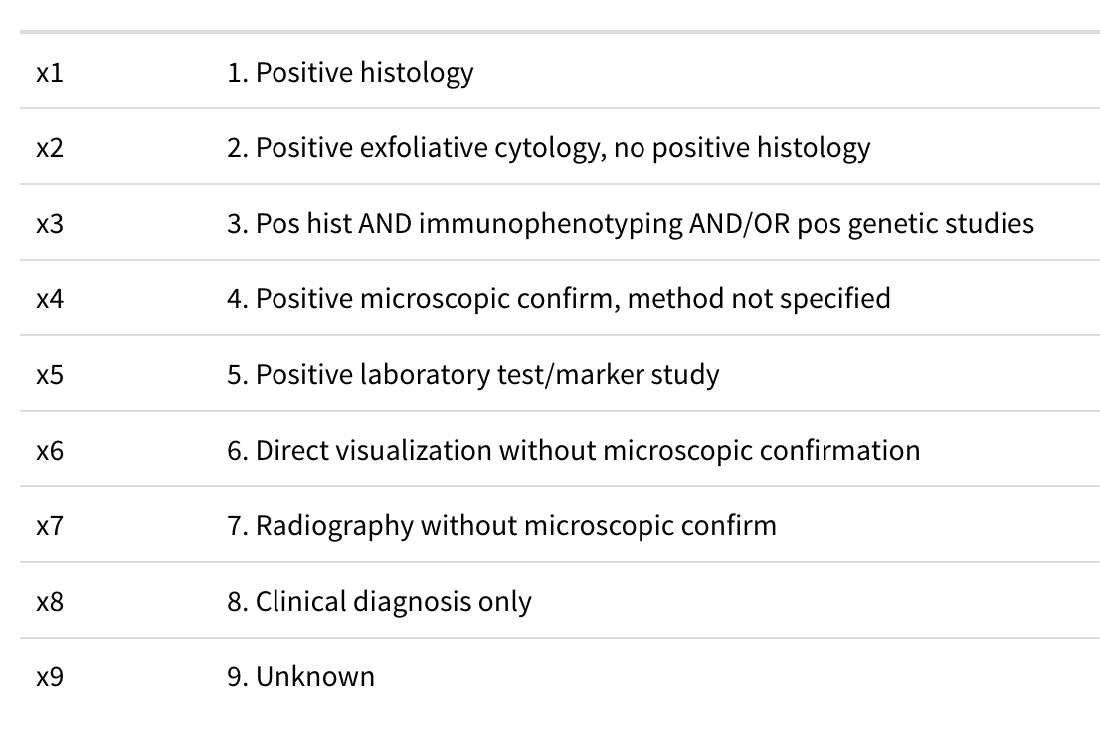
{
Diagnosed by microscopy

Slide 3
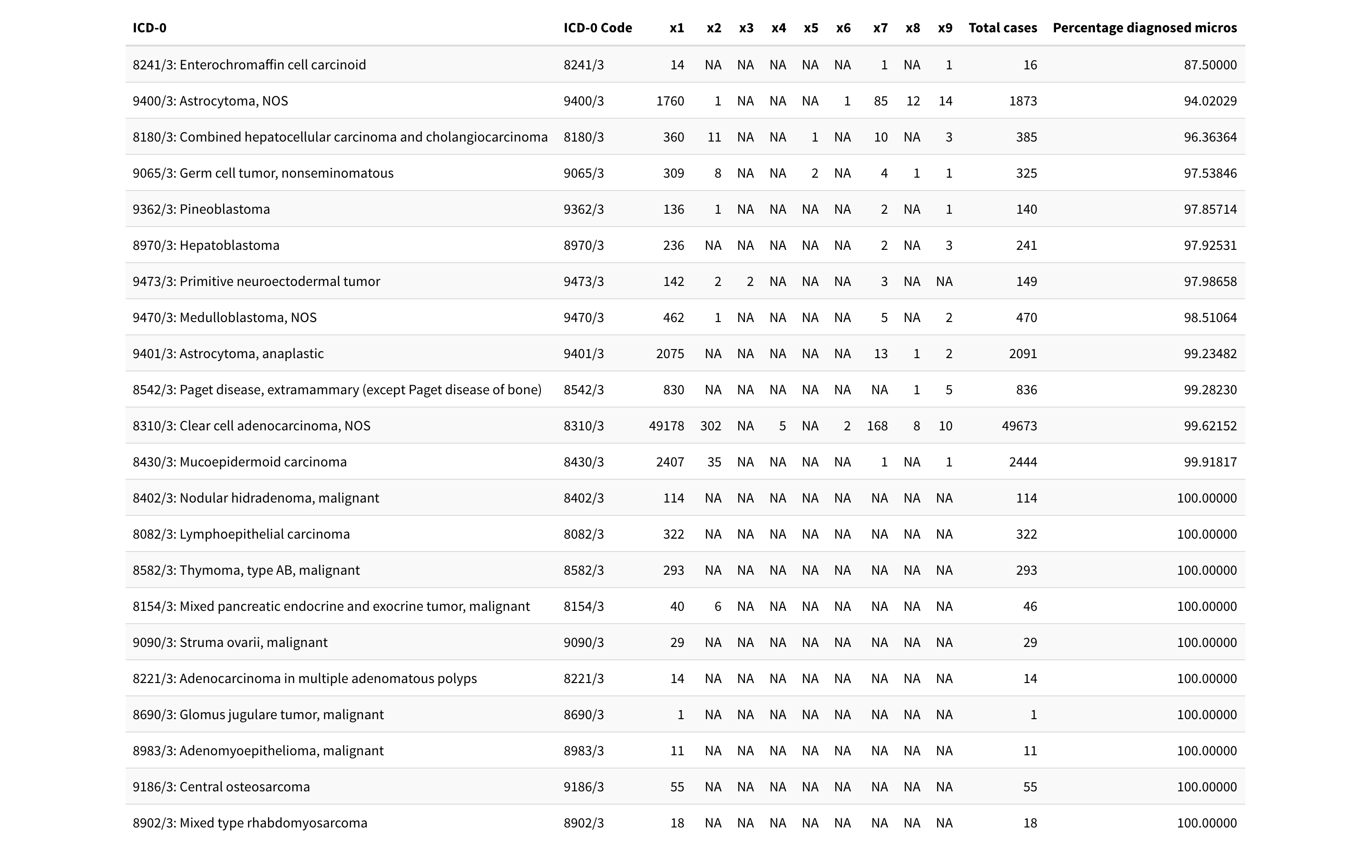
{
Solid Tumors

Slide 4
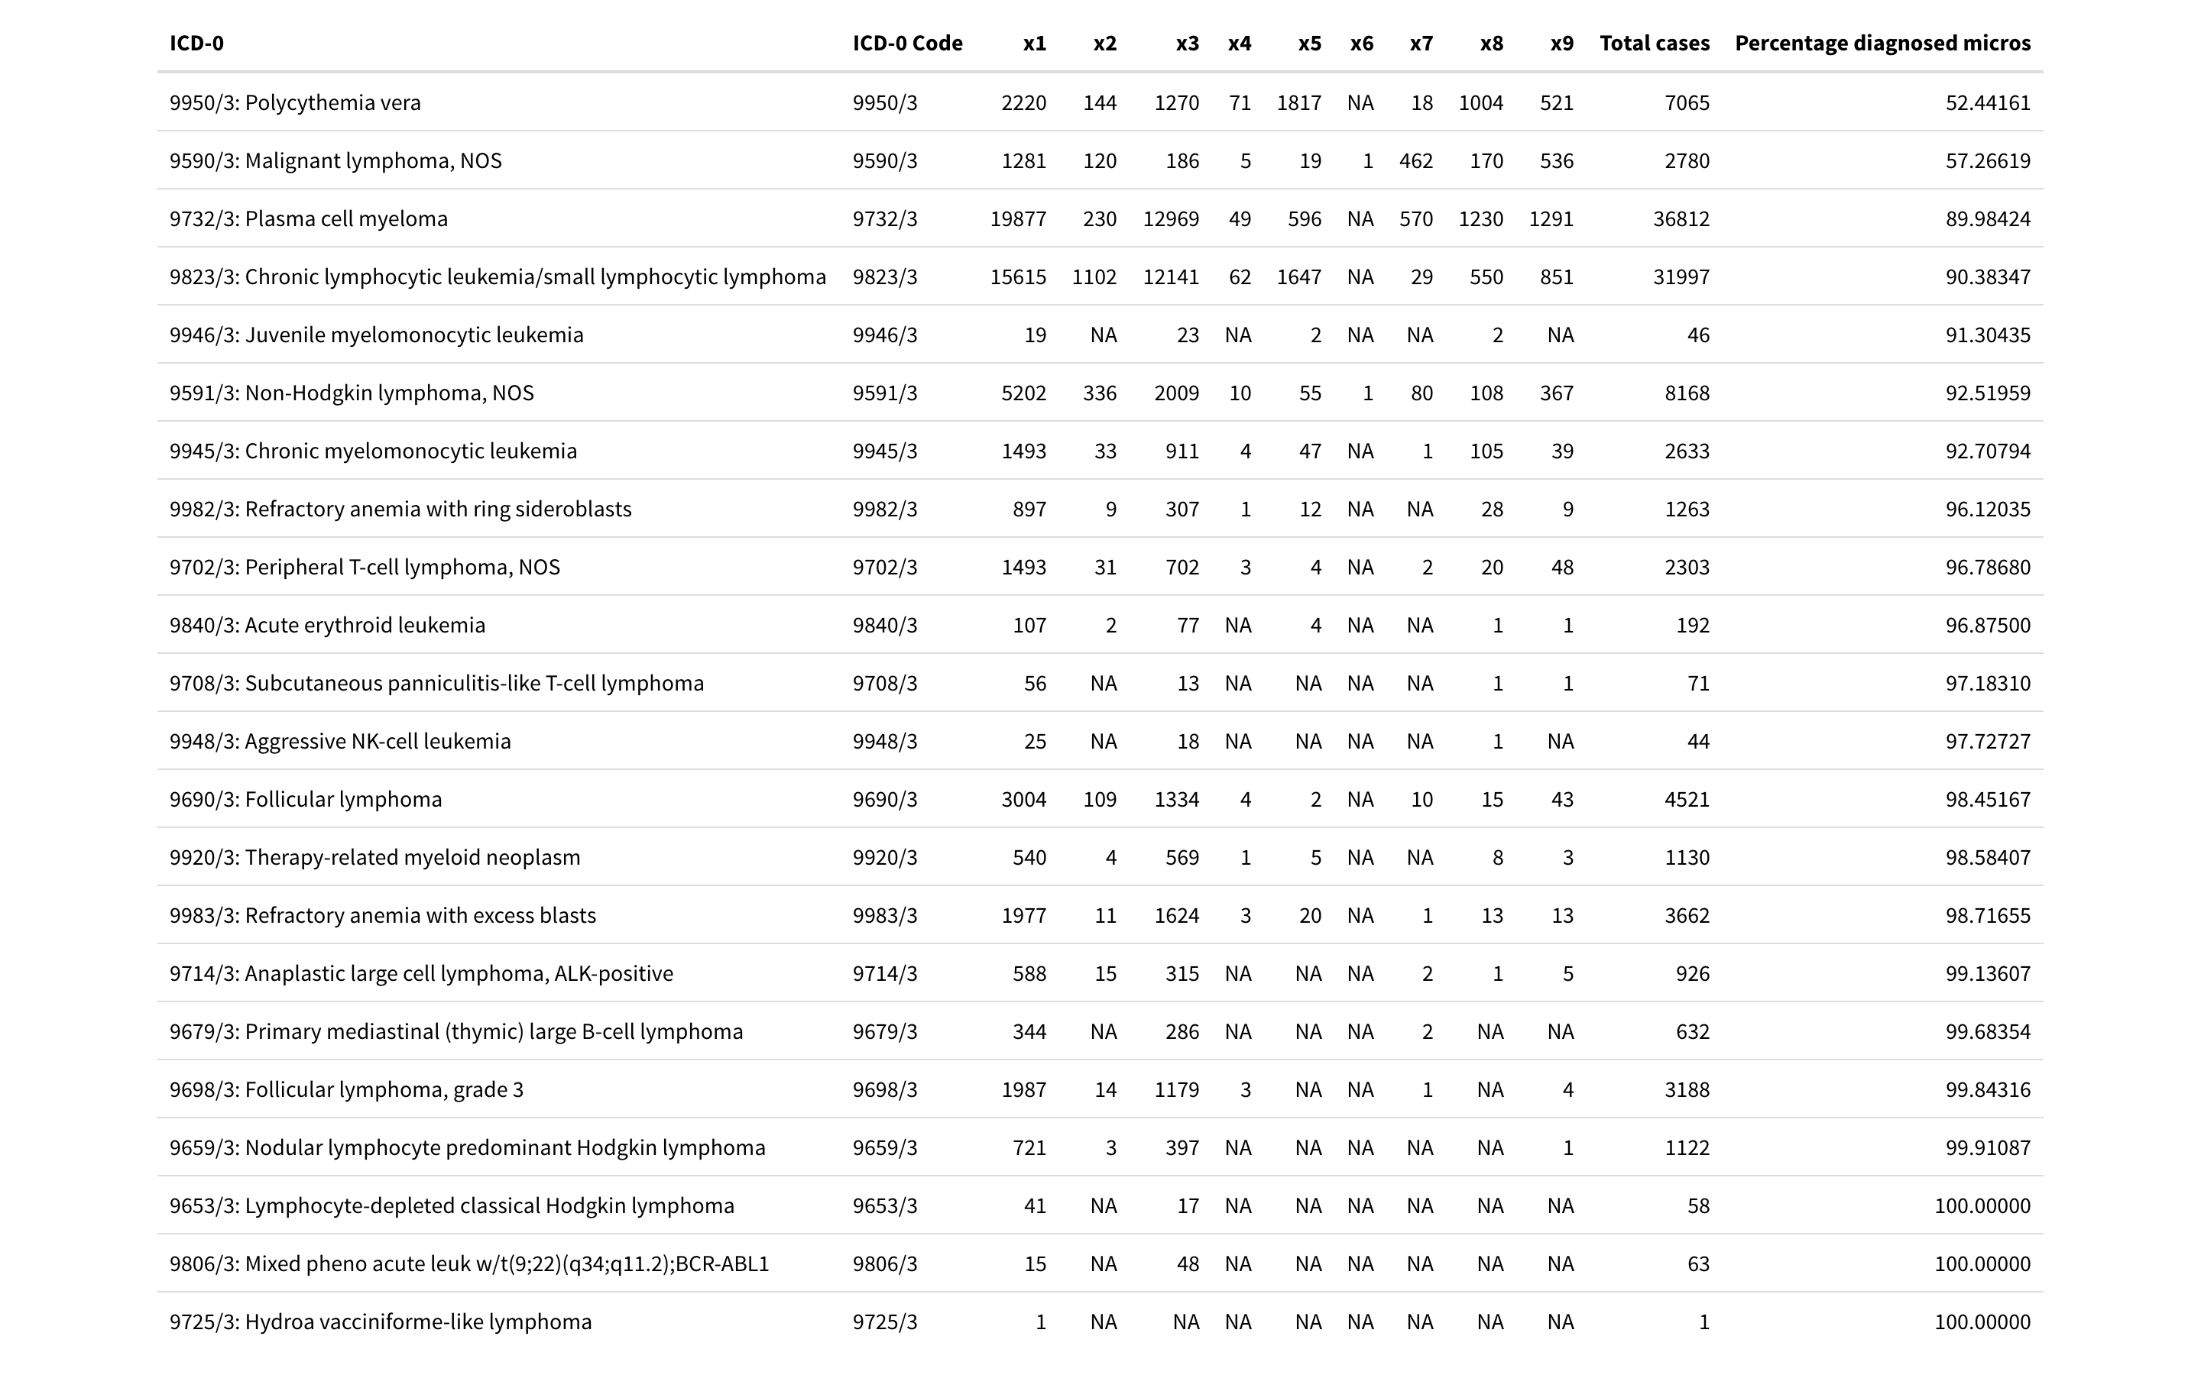
{
Heme Tumors

