Slide 1
Biomarker Testing Health Insurers Will Be Required To Cover Cancer Testing In RI
Gov. Dan McKee's signed
Insurers will have to cover biomarker testing, beginning in 2024

Slide 2
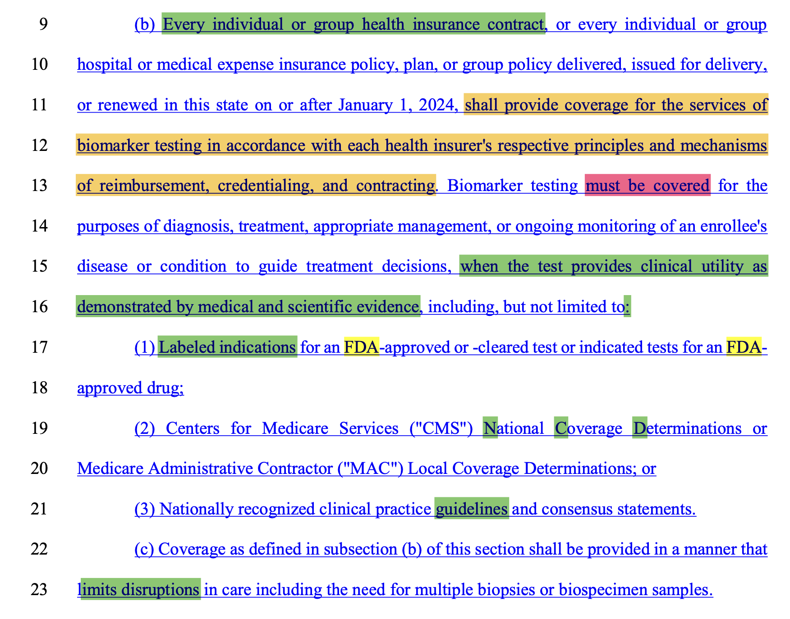
What will this act anable?

Slide 3
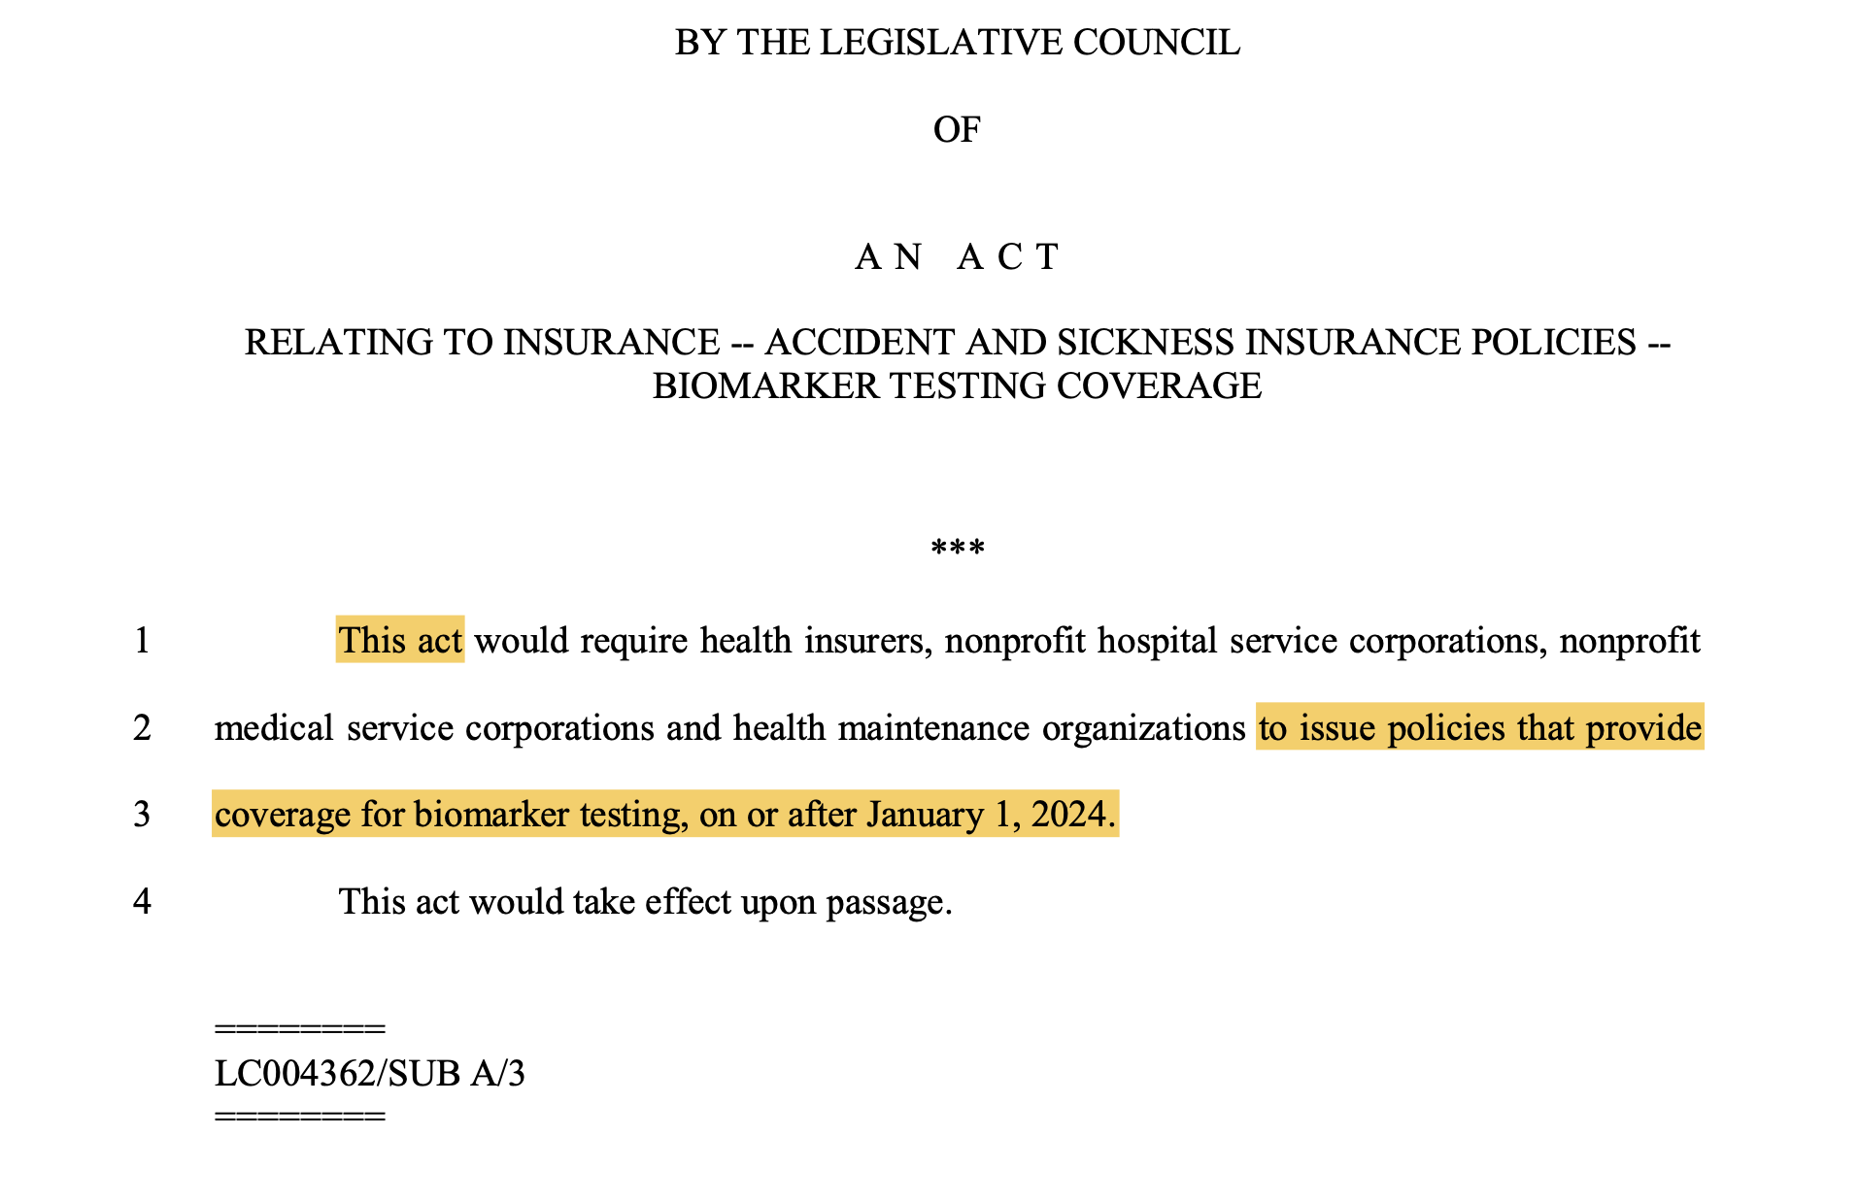
When and how will this act go into effect?

