Slide 1
Data Review II Meeting
PATHOLOGY INNOVATION COLLABORATIVE COMMUNITY
May 27, 2022

Slide 2
Agenda
Project Overview
Data Pull Steps
Data Files Review
Data Analysis
New Technology Trends

Slide 3
Key Question: To what degree do pathologists depend on light microscopy for cancer diagnosis?
No clear answer offered by current literature
Relevant in the wake of rapid development of digital pathology, AI, cell-free DNA and liquid biopsy
Primary endpoint: Percentage of cancer diagnoses rendered by light microscopy for national extrapolation
Secondary endpoints: To find the percentage of microscopically diagnosed cancers
By ICD-O code
By primary site
By state of patient residence
Notes:
Small recap of what the goal of the project is

Slide 4
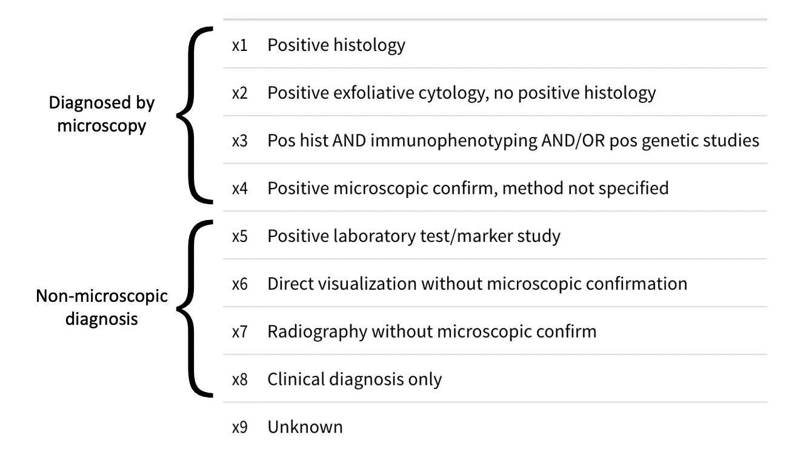
Diagnostic Confirmation

Slide 5
Data Pull Steps
Began project working with the ‘Incidence – SEER Research Limited-Field Data, 21 Registries, Nov 2020 Sub (2000-2018)’ Dataset
Apr. 2022: ‘Incidence – SEER Research Limited-Field Data, 22 Registries, Nov 2021 Sub (2000-2019)’ Dataset became available
Additional year (2019) of data available
More comprehensive counts for prior years

Slide 6
Data Analysis

Slide 7
SEER Data Use Agreement

Slide 8
Trends in New Technologies
”Digital pathology”
”Artificial Intelligence”
”Cell free”
”Liquid biopsy”
Notes:
Pubmed results of phrases,, rapid adoption of these technologies

