Slide 1
Forging Agile Regulatory Frameworks in an Environment of Accelerating Technical Change
Video Conference 21 January 2021
Dr. George Poste
Regents’ Professor and Del E. Web Chair of Health Innovation Arizona State University George.Poste@asu.edu

Slide 2
Conflict of Interest
Board Member
Board Member

Slide 3
The Evolution and Adoption of New Technology Platforms in Laboratory Medicine and Pathology
convergence
computing
complexity
culture

Slide 4
Convergence

Slide 5
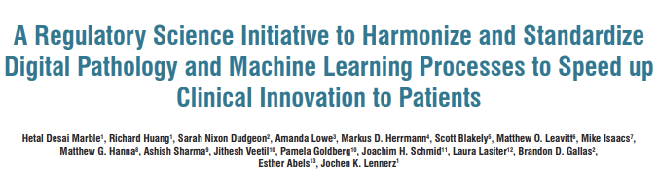
unlock the potential of digital pathology
integration of molecular pathology (multiOmics), imaging platforms, computational and data sciences, ML/AI and decision-support tools
https://www.jpathinformatics.org/temp/JPatholInform11122-8258127_225621.pdf

Slide 6
Digital Pathology
multiplex, multiOmics assays and assay automation
granularity and multi-feature extraction
scale and diversity of datasets (exabytes and beyond)
software as medical device (SaMD)
validation of machine learning (ML)/artificial intelligence (AI) and adaptive algorithms
fully automated and autonomous decision systems vs ‘human-in-the-loop’
future education and training needs
regulation and reimbursement

Slide 7
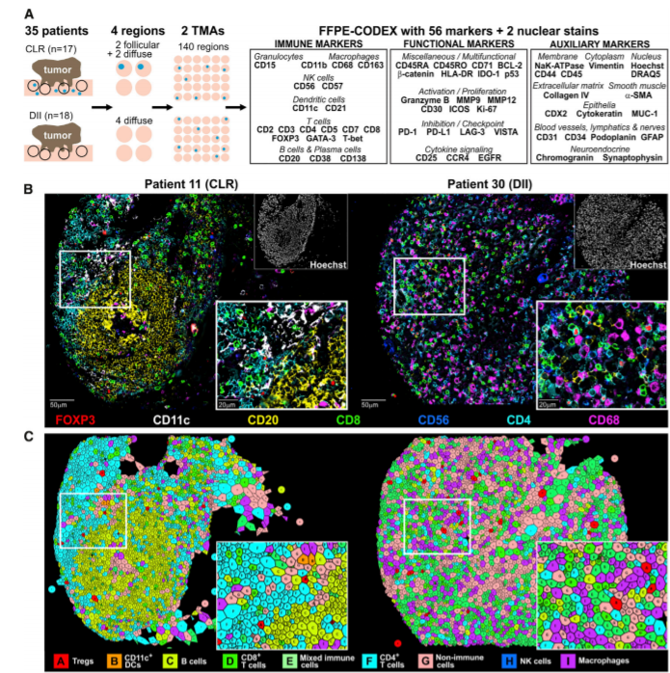
Mapping the Tumor Microenvironment:
56 Multiplex Marker Spatial Profiling of Immune Cell Infiltrates in CRC
From: C.M. Schurch et al. (2020) Cell 182, 1341

Slide 8
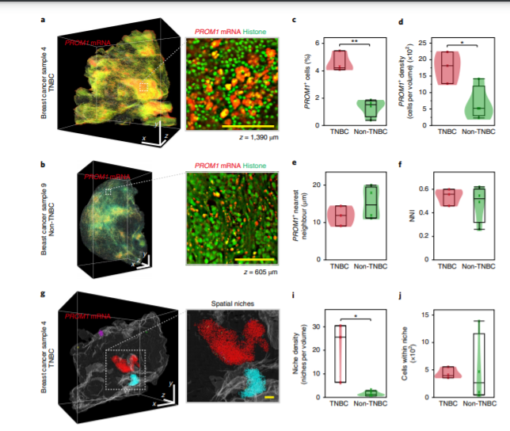
3D-Single Cell Analysis of RNA and Protein Expression in Intact Tumor Biopsies
From: N. Tanaka et al. (2020) Nat. Biomed Eng. 4, 875

Slide 9
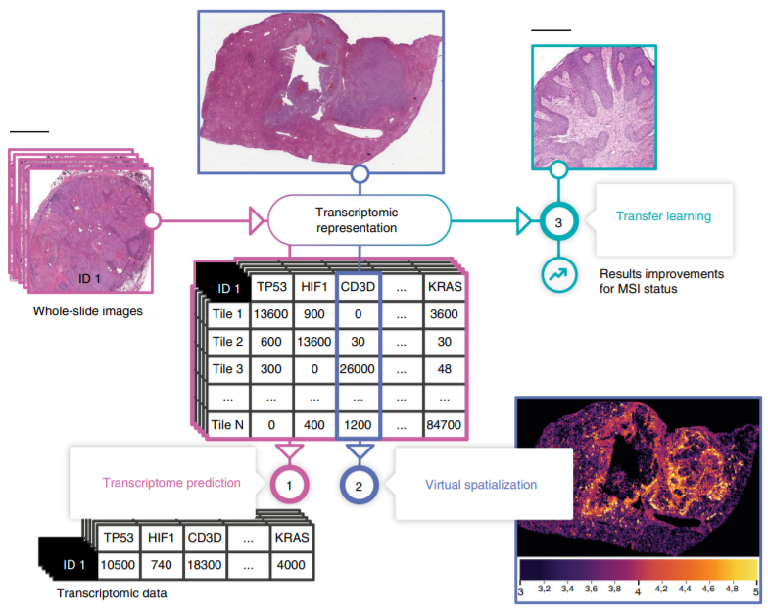
Neural Network Training for Transcriptome Profiling from
Whole Slide H&E Images (8725 pts: 28 lineages)
From: B. Schmuach et. al. Nature Com (2020) 11, 3877

Slide 10
Computing
massive datasets
new analytical platforms: ML/AI
new regulatory paradigms

Slide 11
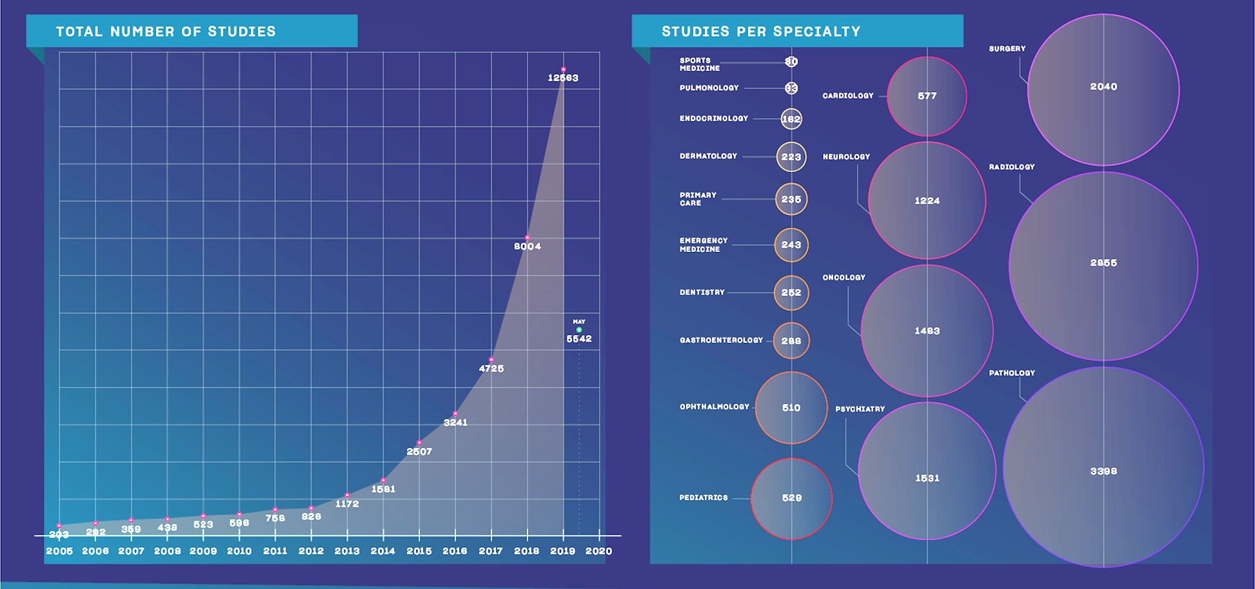
Rapid Proliferation of Biomedical Publications Citing Use of ML/AI Platforms
Pubmed and B. Mesko and M. Gorog (2020), Nat. Dig. Med. 3,126

Slide 12
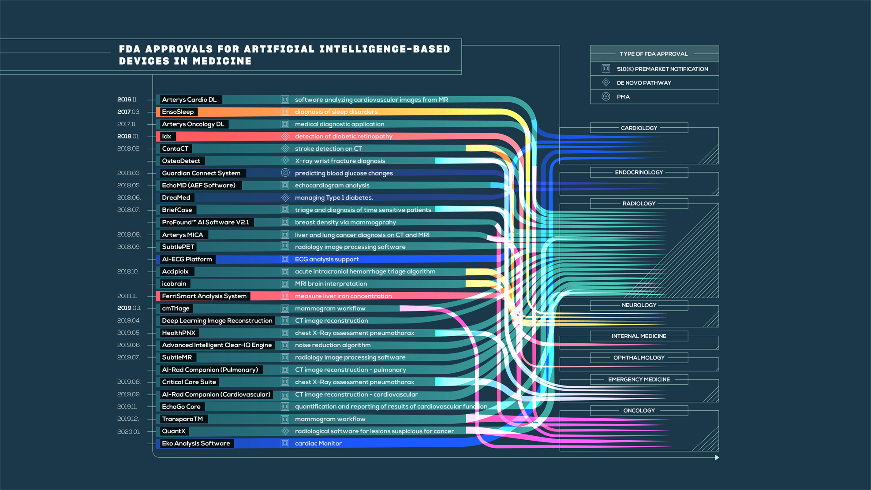
29 FDA Approved ML/AI-Based Medical Technologies
S. Benjamens et. Al. (2020), Nat. Dig. Med. 3,118

Slide 13
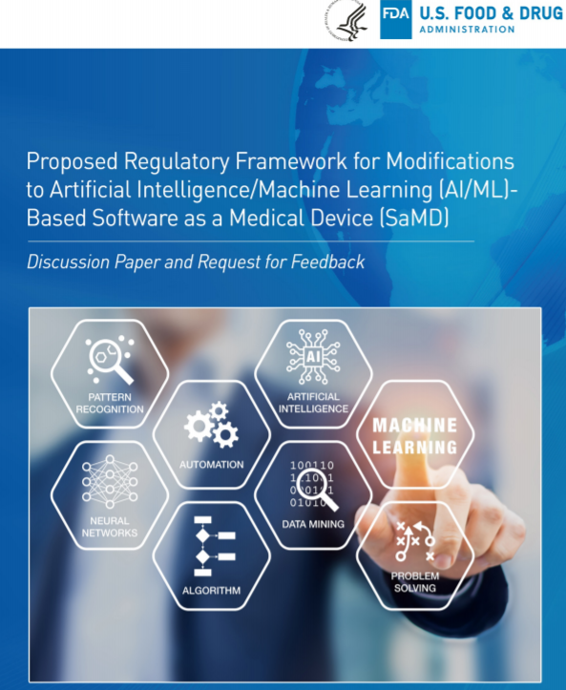
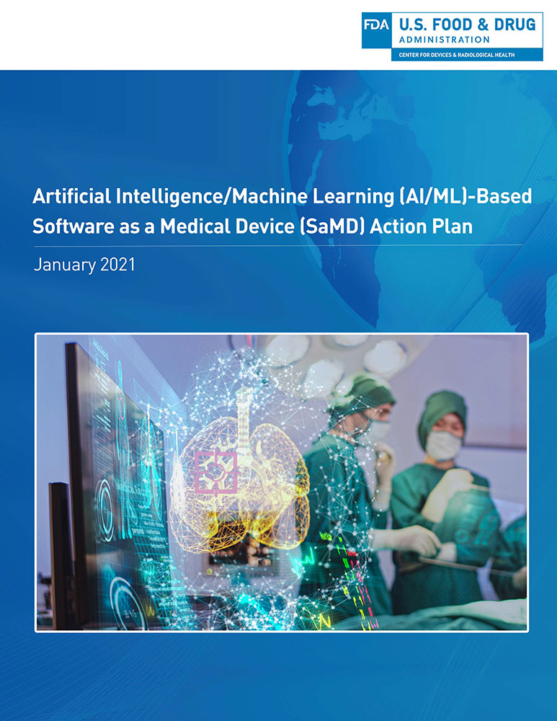

Slide 14
ML/AI-Based Medical Devices and Algorithms
definitional clarity and thresholds for oversight (low to high complexity applications)
‘locked’ algorithms (same input same output)
‘adaptive’ algorithms (outputs change with new inputs:learning)
Total Product Life Cycle (TPLC) approach based on Agency’s Digital Health Software Precertification (Pre-Cert) Program and Software as Medical Device (SaMD)
full PMA submission

Slide 15
Artificial Intelligence/Machine Learning (AI/ML)-Based Software as a Medical Device Action Plan (January 2021)
Good Machine Learning Process (GMLP)
transparency to end users of SaMD benefits and risks
methods for evaluation of bias
pilot programs for real-world performance (no timeline proposed)

Slide 16
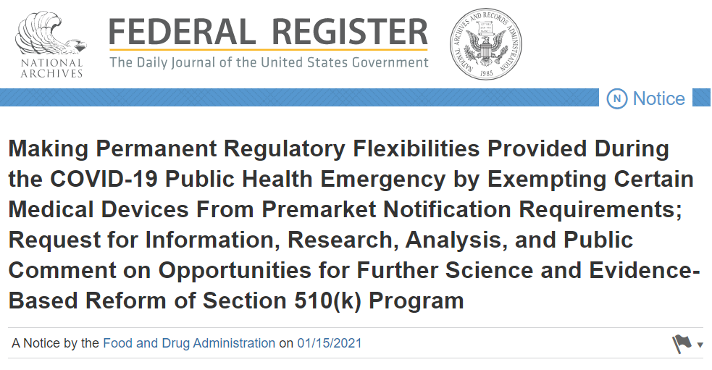
https://www.federalregister.gov/documents/2021/01/15/2021-00787/making-permanent-regulatory-flexibilities-provided-during-the-covid-19-public-health-emergency-by#:~:text=Notice-,Making%20Permanent%20Regulatory%20Flexibilities%20Provided%20During%20the%20COVID%2D19%20Public,Reform%20of%20Section%20510(k)

Slide 17
Just What the Data Ordered
Machine Intelligence and Algorithms for Clinical Diagnosis and Treatment Decisions
Black Box Medicine?

Slide 18
Bias: The Omnipresent Danger in ML/AL Datasets
underpowered training sets
institution-specific data and bias
risk to patients
Instructive precedent for more stringent AI validation standards
IBM Watson and Cancer Care
Overpromised
and
Underdelivered

Slide 19
Fundamental Questions in the Application of ML/AI in Biomedical Research and Clinical Care
what aspects of current practice are being addressed?
reinforce, improve, abandon
does the training data set match the multi-dimensional matrix of real-world activities?
how are training and validation data sets interrogated for bias?
if the output differs markedly from other seemingly comparable data sets, why?
have the algorithms been validated by independent experts (private, public)?
how will regulators accommodate accelerating pace of changes in inputs, code and outputs (V₁, V₂, V_{n}….)?
will the data, coding and analytical algorithms be publicly available?

Slide 20
Fundamental Questions in the Application of ML/AI in Biomedical Research and Clinical Care
what are the operational boundaries of the claimed utility?
how does performance vary when used by individuals with different skill levels?
what services/products will use the platform?
what legal exposures may arise from intrinsic (developer organization) or extrinsic use (others)?

Slide 21
Complexity
systems-based integration
of large and increasingly diverse data streams

Slide 22
Precision Health and Digital Health: The Evolution of a Data-Centric Ecosystem
multiOmics and mapping biological information networks
network deconvolution and
geno-phenotype relationships
patient match:
“digital twins” and optimized clinical interventions
spatio-temporal dynamics of disease progression
data integration:
the grand challenge
clinical regimens
and outcomes
EHR integration of molecular, clinical and SDoH data

Slide 23
Welcome to The World of Biomedical Research and Healthcare Information Systems

Slide 24
Biomedical Data: Vast But Poorly Utilized
inadequate standardization
fragmented, incomplete, inaccurate data and uncertain provenance
incompatible data formats as barrier to data integration and sharing
obstacles to EHR integration of new data classes (multi-Omics; wearables; IoMT)
legislative barriers to data transfer based on well intentioned privacy protections (HIPAA)
organizational, economic and cultural barriers to open data sharing
static, episodic snap shots of complex dynamic systems
major impediments to research productivity, optimum clinical decisions and continuity-of-care for patients

Slide 25
Precision Health and Digital Health: Building a Learning Healthcare System
qualitative, descriptive information of variable quality and provenance
quantitative data of known provenance and validated quality
evolving, inter-connected networks of data sources for robust decisions and improved care
complex ecosystem of largely unconnected
data sources

Slide 26
A Pending Transition in Biomedical Research and Clinical Care Decisions?
quantitative data
large scale data mining
automated analytics
clinical decision support systems
descriptive qualitative data
hypothesis-driven inquiry
hypothesis-driven
dominant
data mining
dominant

Slide 27
The Big Data Challenge
I-3
V-7
D-3
infrastructure
investment
intelligent systems
dynamic
distributed
decision-support
volume
velocity
variety
veracity
visualization
virtualization
VALUE !

Slide 28
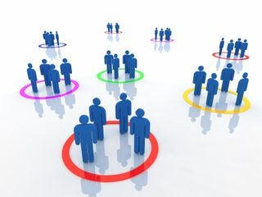
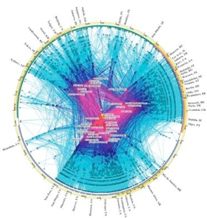
Big Data Changes the Questions That Can Be Asked
Isolated
Data
Complex Networked Data
Complex Computational Data

Slide 29
Data Labeling as a Major Bottleneck in ML/AI: The Premium for the Shift from Supervised to Unsupervised Learning
“Labels are the opium of the machine learning research.”
Jitendra Malik, UC Berkeley
“The next AI revolution will not be supervised.”
Yann LeCun, NYU and
Chief Scientist, Facebook

Slide 30
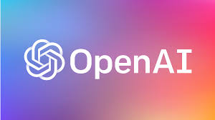
Transformers and NLP
parallelized processing versus recurrent neural networks sequential processing
BERT
ROBERTA
GPT-2, GPT-3

Slide 31
Automated Classification, Search and Retrieval
Deep Understanding of Content and Context
Collapse Time to Decision: Intelligence at Ingestion
Automated and Proactive Analytics: Why Wait for the Slow Brain to Catch Up to the Fast Machine

Slide 32
Automated Context: Data Finding Data “Intelligence at Ingestion”
Feature
Extraction and Classification
Context Analysis Persistent Context
Knowledge Topologies
Learning Systems
Data Fidelity
Rapid, Robust Decisions

Slide 33
Culture
Misaligned Incentives in Biomedical Research
and Healthcare Delivery
Silos Subvert Solutions

Slide 34
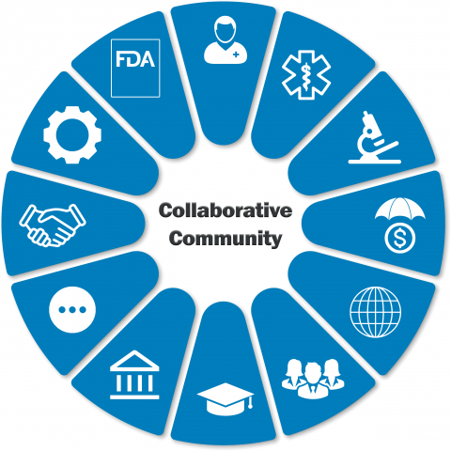
https://www.fda.gov/about-fda/cdrh-strategic-priorities-and-updates/collaborative-communities-addressing-health-care-challenges-together

Slide 35
Biomedical Research: Silos and Misaligned Incentives
different cultures, incentives and rewards
academia, providers, payors, industry, investors
dominance of reductionist science in public funding policies
individual-centric versus team-based incentives
slow recruitment and statistically underpowered investigator-initiated clinical trials vs private sector scale
stark contrast with organization and adoption of systems-based integration of large-scale data initiatives in non-medical sectors
physics, astronomy, oceanography
military R&D and defense industry
financial services
supply chain logistics

Slide 36
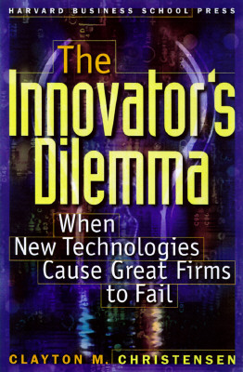
Creative Destruction and Disruptive Innovation
radical disruption always occurs at the margins of existing fields or at points of convergence between previously separate fields
the competitive threat posed by disruptive vectors of innovation are typically denied by the current leading institutions, companies and public policy decision makers
siloed organizations and cultures are often ill-suited to adapt to rapid and/or disruptive changes

Slide 37
Technology Innovation and Creative Destruction
emergence at
margin of an existing domain
emergence by
convergence of previously separate domains
multi-Omics and precision medicine
big data, AI and digital medicine
biotechnology
1980-present

Slide 38
Cultural Barriers to Adoption of Innovation
Denial
Negativity
Resistance

Slide 39
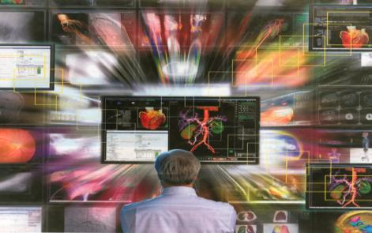
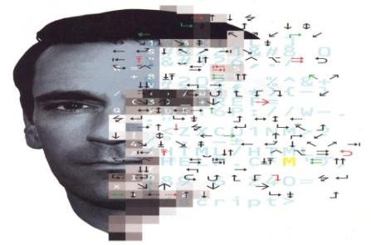
Technology Acceleration and Convergence: The Escalating Challenge for Professional Competency, Decision-Support and Future Medical Education
Data Deluge
Cognitive Bandwidth Limits
Automated Analytics and Decision Support
Facile Formats for Actionable Decisions

Slide 40
Living in a World Where the Data Analytics and Interpretation Algorithms Are Obscure to the End User
ceding decision authority to computerized support systems
culturally alien to professionals in their claimed expertise domain but they accept in all other aspects of their lives
who will have the responsibility for validation and oversight of critical assumptions used in decision tree analytics for big data?
regulatory agencies and professional societies?
machines?

Slide 41
Machine Learning (ML), Artificial Intelligence (AI) and Healthcare
how will professional competencies in using ML-AI decision-support tools be developed and sustained?
MD curriculum, CME
non-medical data science professionals
regulatory agencies
what new malpractice liabilities will emerge by failure to use/interpret ML-AI platforms?

Slide 42
“Digital Darwinism”: A Looming Digital Divide
understanding data structure and its productive application/customization for improved decisions and clinical outcomes will become a critical institutional competency
major skill gaps and personnel shortages in biomedicine
training of a new cadre of data scientists (medical and non-medical)
institutions lacking adequate computational infrastructure and critical mass in data analytics will suffer ‘cognitive starvation’ and relegation to competitive irrelevance

Slide 43
Digital and Molecular Pathology: Data-Centric Disciplines Nested in Larger Networks of Health Care Data
convergence
computing
complexity
culture
life sciences
engineering
data science
social sciences (SDoH)
data standards
scale
infrastructure
new analytical platforms (ML/AI)
integration of diverse data classes
complex system dynamics
automated decision systems
oversight and regulation
silos vs systems
incentives and rewards
accelerating disruption
education and training

Slide 44
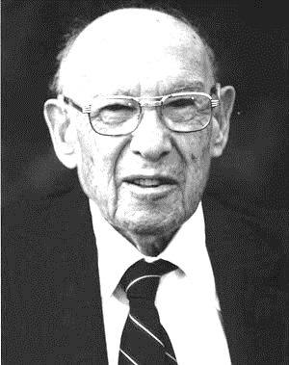
“The greatest danger in times of turbulence,
is not the turbulence,
it is to act with yesterday’s logic.”
- Peter Drucker

Slide 45
Slides available at: https://casi.asu.edu/presentations/

